Slide 1
7FNCE040W
Business Analytics
WEEK 6 Bite

Slide 2
Factor Analysis.

Slide 3
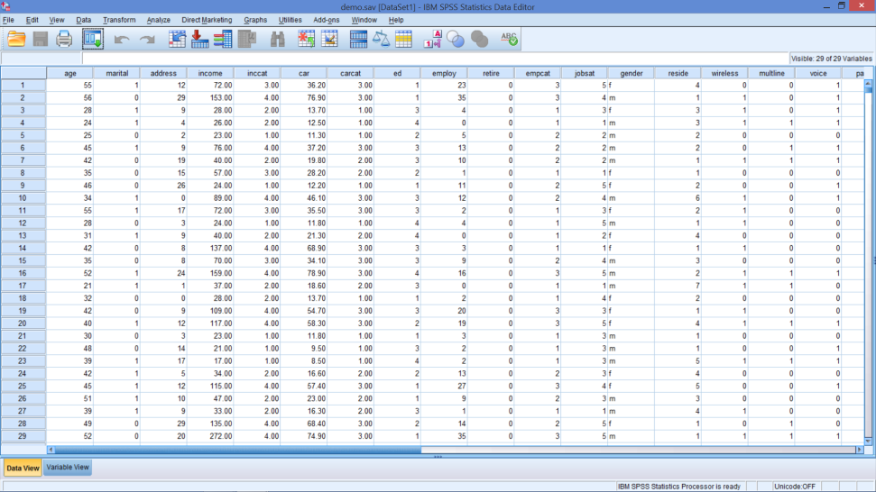

Factor versus Cluster Analyses
Factor – Group Variables
Cluster – Group Cases
Factor 1
Factor 2
Factor 3
Factor 4
Cluster 1
Cluster 2
Cluster 3

Slide 4
Factor Analysis
The Intuition & Mechanics

Slide 5

What comes to mind?
Comfortable
Headroom
Legroom
Seating
Economical
Repairs / Maintenance
Fuel efficiency
Purchase Price
Safe
Air bags
Braking system
Construction
Convert 9 → 3 attributes
Notes:
For each attribute above, there are probably several features of the car that contribute to the feature
Use factor analysis to see which features go together and name the ‘super’ attribute that represents the set

Slide 6
Factor Analysis
Data reduction and summarisation
Exploit correlations among variables
Uses
Correct for multicollinearity
Data reduction
Construct validity
Notes:
Factor analysis is a general name denoting a class of procedures primarily used for data reduction and summarization.
Factor analysis is an interdependence technique in that an entire set of interdependent relationships is examined without making the distinction between dependent and independent variables.
Factor analysis is used in the following circumstances:
To identify a new, smaller, set of uncorrelated variables to replace the original set of correlated variables in subsequent multivariate analysis (e.g., regression analysis in presence of multicollinearity)
To identify a smaller set of salient variables from a larger set for use in subsequent multivariate analysis (data reduction).
To identify underlying dimensions, or factors, that explain the correlations among a set of variables (construct validity).

Slide 7
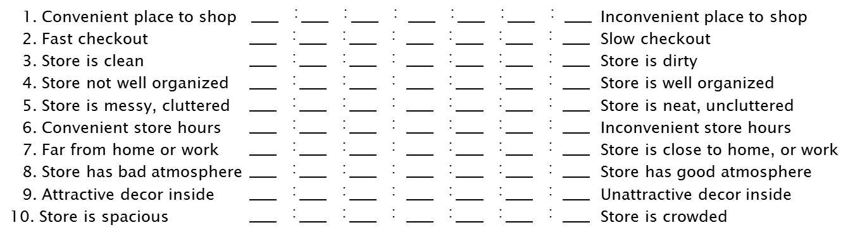
Basic Set-up
Several variables – some are correlated
Do we need all of them?
Can we learn something from correlations?
Notes:
Churchill, Gilbert A. Jr. and Dawn Iacobucci (2005), Marketing Research Methodological Foundations, 9th edition, Thomson South-western Publishers, Figure 18.3, page 575.
Imagine responds are asked about 10 features of their favorite or most frequently visited shop.
Can these 10 variables be combined to a smaller set of variables if yes:
This makes development of communications easier (comfort versus all three features)
It also makes further analysis more efficient because fewer coefficients to estimate in a regression, for example.

Slide 8
The Basic Idea - Intuition
x₁
x₃ |  | Factor 1
x₃
x₄
x₅
x₆
x₇ |  | Factor 2
x₈
x₉
x₁₀
Notes:
Adapted from Churchill and Iacobucci (2005), Figure 18.5, page 578.

Slide 9
EFA and PCA
Exploratory Factor Analysis (EFA)
Principal Component Analysis (PCA)
EFA and PCA are often used interchangeably
Measurement / Statistical Model
Mathematical procedure
Used to find:
Minimum number of factors
Accounting for maximum variance in data
Notes:
EFA is used when you don’t know which items will go together – it’s an exploration of the correlations
PCA is the most common procedure for conducting factor analysis, so don’t be confused if people refer to factor analysis as PCA

Slide 10
Factor Model – Theory
 | Unobserved Factors
Observed Variables
x₁ | = λ₁₁f₁ + λ₁₂f₂ | + λ₁₃f₃ + λ₁₄f₄ | + ε₁
x₂ | = λ₂₁f₁ + λ₂₂f₂ | + λ₂₃f₃ + λ₂₄f₄ | + ε₂
x₃ | = λ₃₁f₁ + λ₃₂f₂ | + λ₃₃f₃ + λ₃₄f₄ | + ε₃
x₄ | = λ₄₁f₁ + λ₄₂f₂ | + λ₄₃f₃ + λ₄₄f₄ | + ε₄
 | Factor Loadings
Notes:
Where:
x_{i} = i^{th} standardized variable
λ_{ij} = standardized multiple regression coefficient of variable i on common factor j
f_{i} = common factor
ε_{i} = the unique factor for variable i
Mathematically, each variable is expressed as a linear combination of underlying factors.
The covariation among the variables is described in terms of a small number of common factors plus a unique factor for each variable.
Because of the different units of the variables studied, they are usually standardized, such that each has a mean = 0 and variance = 1.

Slide 11
Factor Model – Theory
 | Unobserved Factors
Observed Variables
x₁ | = λ₁₁f₁ + λ₁₂f₂ | + λ₁₃f₃ + λ₁₄f₄ | + ε₁ | x₁ = f₁
x₂ | = λ₂₁f₁ + λ₂₂f₂ | + λ₂₃f₃ + λ₂₄f₄ | + ε₂ | x₂ = f₂
x₃ | = λ₃₁f₁ + λ₃₂f₂ | + λ₃₃f₃ + λ₃₄f₄ | + ε₃ | x₃ = f₃
x₄ | = λ₄₁f₁ + λ₄₂f₂ | + λ₄₃f₃ + λ₄₄f₄ | + ε₄ | x₄ = f₄
 | Factor Loadings
Trivial solution
Works great! … but no reduction in the dimension of the problem, and no insight offered.
Notes:
A factor is a linear combination of variables, chosen to capture the “essence” of the data.
Clearly if we let f₁=x_{1,,} f₂=x_{2 ,} etc. we will have a perfect model.
We won’t loose any information.
All the ε’s will =0
However we haven’t accomplished any data reduction.

Slide 12
Factor Model – Theory & Goal
 | Unobserved Factors
Observed Variables | Unique factor or “error”
x₁ | = λ₁₁f₁ + λ₁₂f₂ + ε₁
x₂ | = λ₂₁f₁ + λ₂₂f₂ + ε₂
x₃ | = λ₃₁f₁ + λ₃₂f₂ + ε₃
x₄ | = λ₄₁f₁ + λ₄₂f₂ + ε₄
 | Factor Loadings
Want fewer factors
Use f₁ and f₂ in additional analysis
Without losing information
Variance in observed variables
Notes:
The unique factors are uncorrelated with each other and with the common factors.
Instead, we would like fewer factors.
But, we don’t‘ want to lose much information (variance)
So, the idea is to exploit correlations
Intuitively, if some variables are already correlated then they are capturing the same thing
If we put them all together, we can have one big attribute capturing all of the underlying variables
In our final solution, the unique factors are uncorrelated with each other and with the common factors.

Slide 13
Principal Component Analysis
“Invert” the solution to get estimates of f’s
New variables |  | Weights (or Factor Score Coefficients)
f₁ | = w₁₁x₁ + w₁₂x₂ + w₁₃x₃ + w₁₄x₄
f₂ | = w₂₁x₁ + w₂₂x₂ + w₂₃x₃ + w₂₄x₄
f₃ | = w₃₁x₁ + w₃₂x₂ + w₃₃x₃ + w₃₄x₄
f₄ | = w₄₁x₁ + w₄₂x₂ + w₄₃x₃ + w₄₄x₄
Observed Variables
No Error
Notes:
Principal Components inverts the system of equations so that each factor is expressed as a linear combination of the observed variables.
Where:
f_{i} = estimate of i^{th} factor
w_{i} = weight or factor score coefficient
Principal components is the recommended analysis when the primary concern is to determine the minimum number of factors that will account for maximum variance in the data for use in subsequent multivariate analysis. The factors are called ‘principal components’.
The common factors themselves can be expressed as linear combinations of the observed variables.
It is possible to select weights or factor score coefficients so that the first factor explains the largest portion of the total variance.
Then a second set of weights can be selected, so that the second factor accounts for most of the residual variance, subject to being uncorrelated with the first factor.
This same principle could be applied to selecting additional weights for the additional factors.
Mathematically, factor analysis is somewhat similar to multiple regression analysis, in that each variable is expressed as a linear combination of underlying factors.

Slide 14
Principal Component Analysis
Output
Estimates for w’s
Values for f’s
Analysis reveals:
How much of the original variance is explained
Estimates for λ’s
Correlations between f’s and x’s
Decide which factors to keep
f₁ | = w₁₁x₁ + w₁₂x₂ + w₁₃x₃ + w₁₄x₄
f₂ | = w₂₁x₁ + w₂₂x₂ + w₂₃x₃ + w₂₄x₄
f₃ | = w₃₁x₁ + w₃₂x₂ + w₃₃x₃ + w₃₄x₄
f₄ | = w₄₁x₁ + w₄₂x₂ + w₄₃x₃ + w₄₄x₄
Notes:
The factors are determined in a manner where the first captures the most variance, the second captures the second
Captures the second most, etc.
The analyst must decide how many factors to keep
There is a trade-off:
On one hand – want fewest numbers of factors
This would imply 1 factor
On the other hand – want to capture the most variance
This would imply 1 factor for each observed variable

Slide 15
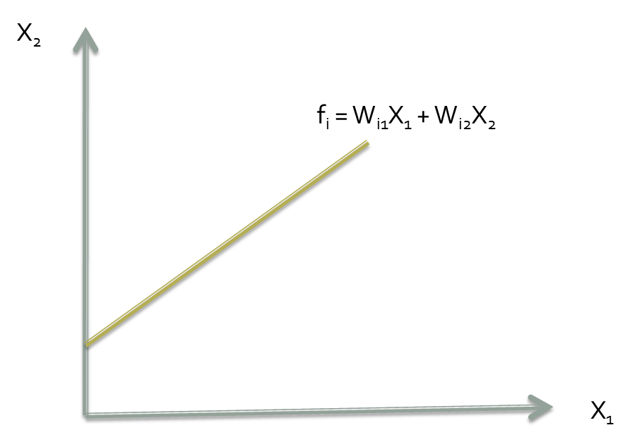
Graphical Illustration
Notes:
Mathematically, factor analysis is somewhat similar to multiple regression analysis, in that each factor is expressed as a linear combination of observed variables.

Slide 16
Principal Component Analysis
Linear combination of existing variables such that:
Var(f1) > Var(f2) > Var(f3) > Var(f4)
All f’s are uncorrelated
f₁ | = w₁₁x₁ + w₁₂x₂ + w₁₃x₃ + w₁₄x₄
f₂ | = w₂₁x₁ + w₂₂x₂ + w₂₃x₃ + w₂₄x₄
f₃ | = w₃₁x₁ + w₃₂x₂ + w₃₃x₃ + w₃₄x₄
f₄ | = w₄₁x₁ + w₄₂x₂ + w₄₃x₃ + w₄₄x₄
Notes:
Principal Component Analysis is a mathematical procedure

Slide 17
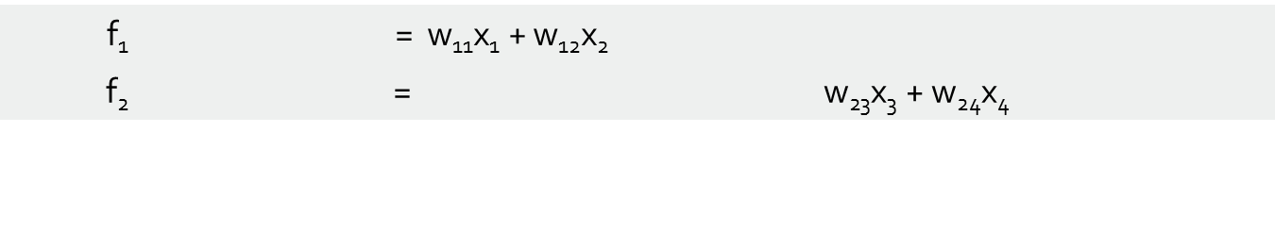
Principal Component Analysis
What we hope for …
Calculate f₁ and f₂ from original variables
Use f₁ and f₂ in additional analysis
Notes:
The analyst’s decision would be easy if the factors worked out that there was no overlap –
that each observed variable fell into one factor
But, it doesn’t work out that way.

Slide 18
Factor Analysis
An Example

Slide 19
An Example: Toothpaste
 | Strongly Disagree |  |  |  |  |  | Strongly Agree
It is important to buy a toothpaste that prevents cavities. | 1 | 2 | 3 | 4 | 5 | 6 | 7
I like a toothpaste that gives shiny teeth. | 1 | 2 | 3 | 4 | 5 | 6 | 7
A toothpaste should strengthen your gums. | 1 | 2 | 3 | 4 | 5 | 6 | 7
I prefer a toothpaste that freshens breath. | 1 | 2 | 3 | 4 | 5 | 6 | 7
Prevention of tooth decay is not an important benefit offered by toothpaste | 1 | 2 | 3 | 4 | 5 | 6 | 7
The most important consideration in buying a toothpaste is attractive teeth. | 1 | 2 | 3 | 4 | 5 | 6 | 7
Notes:
Open toothpaste.sav
30 respondents each rated their level of agreement with these 6 statements regarding toothpaste.
Use on ratio/interval scaled data

Slide 20
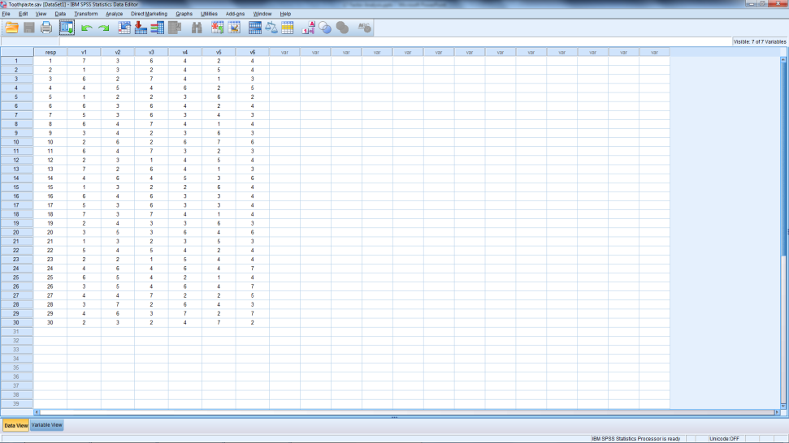
EFA / PCA
Starting Data
Ending Data

Slide 21
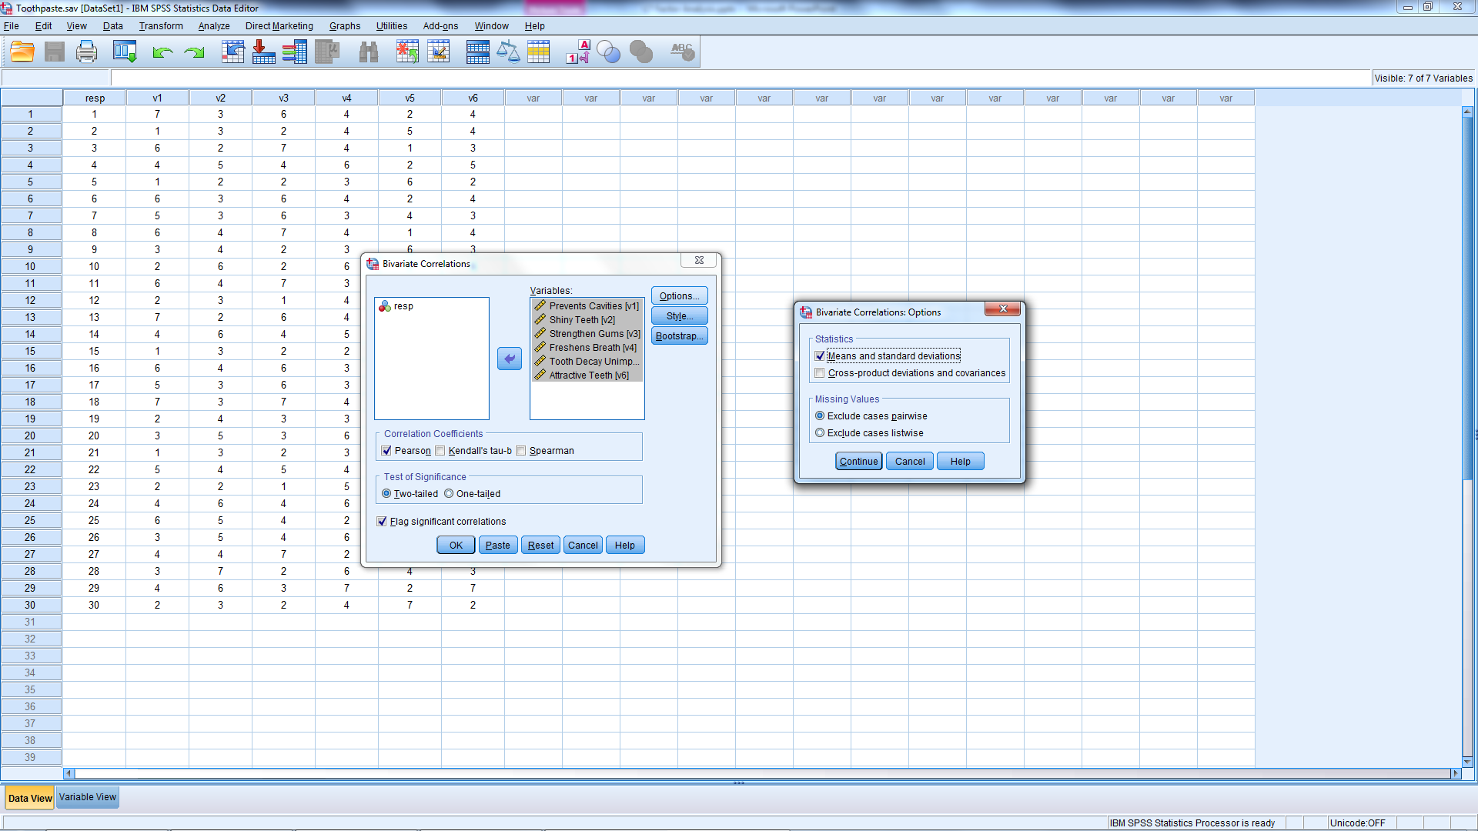
Descriptives & Correlations
Notes:
Please run bivariate correlations for all 6 variables.
In the options menu, please request the means and standard deviations.
Analyse➔Correl➔Bivariate…from
‘’Options’’ tick=➔ Means & standard → continue→OK

Slide 22
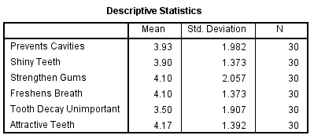
Descriptives
Typically want sample (n) > 50
5 observations per variable
Notes:
While this sample is a bit small, it meets the minimum standard of 5 observations per variable.

Slide 23
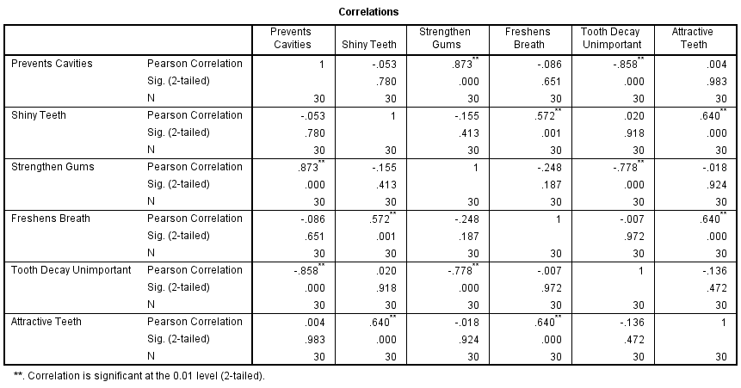
Correlations > .30
Notes:
Look at the correlation matrix first . . .
Are any variables correlated with each other?....’Yes’
For factor analysis to be appropriate, the variables must be correlated. In practice, this is usually the case. If the correlations between all the variables are small, factor analysis may not be appropriate.
The table above provides an indication that factor analysis is suitable for analyzing the data.

Slide 24
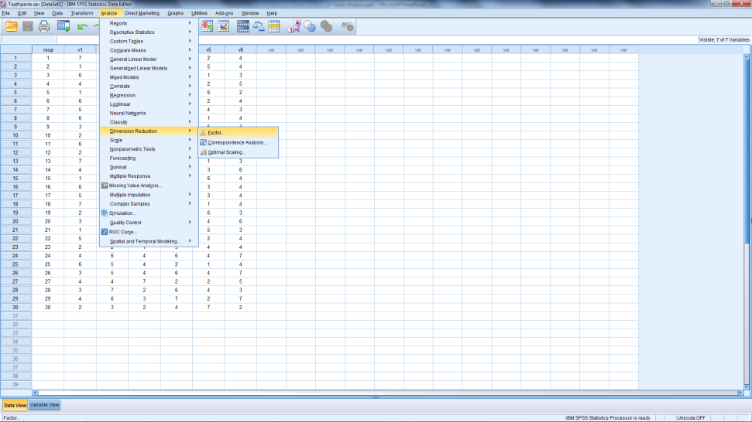
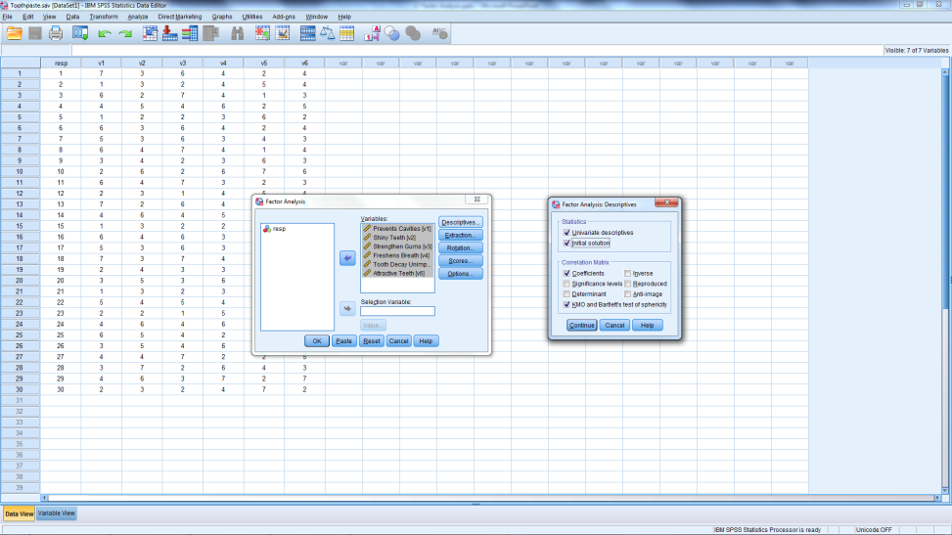
Factor Analysis Steps in SPSS
Analyse Menu
Descriptives Box
Notes:
Analyze → Data Reduction → Factor
Insert all 6 variables into the Variables box
Select the Descriptives box
Note that you could request descriptives and correlations through factor analysis without doing this task separately
Be sure to tick KMO & Bartlett’s Test of Sphericity
Tick box for coefficients too
Continue → Extraction

Slide 25
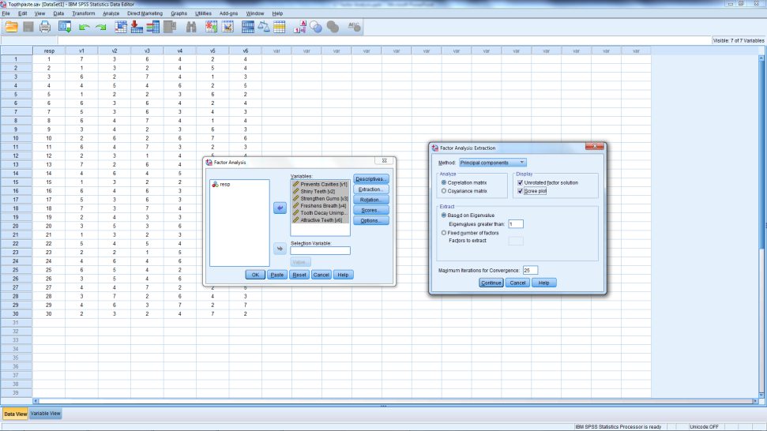
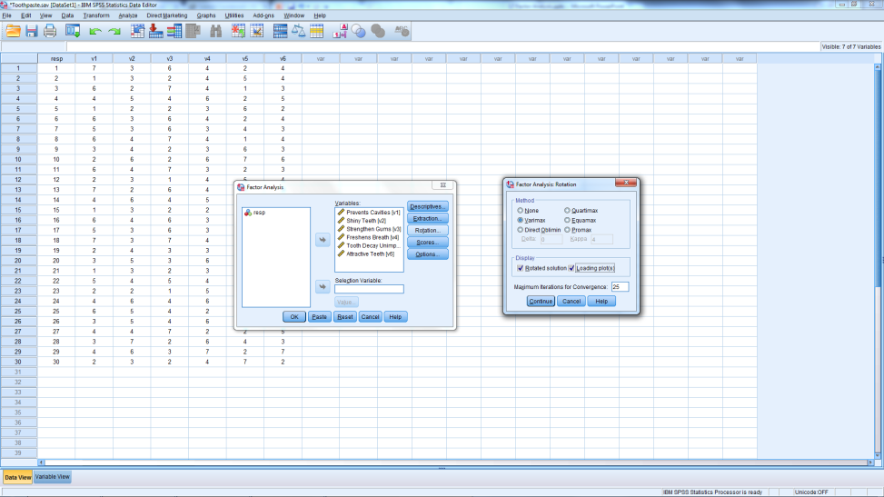
Factor Analysis Steps in SPSS
Extraction Box
Rotation Box
Notes:
Extraction Box:
Be sure to check that Principal Component Analysis is selected
Tick the box for the scree plot
Leave default the eigenvalues > 1 (this will be explained later)
Rotation Box:
Tick varimax rotation
Tick box for the loading plot

Slide 26
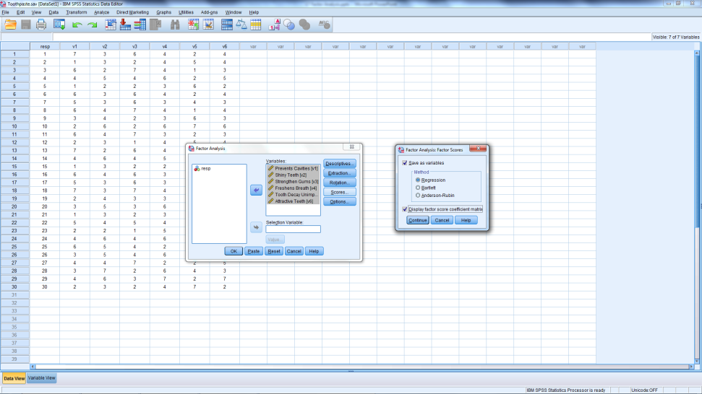
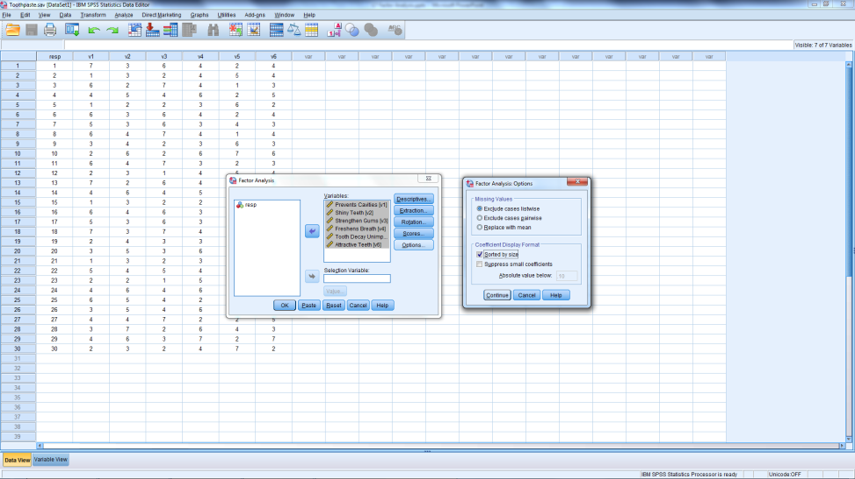
Factor Analysis Steps in SPSS
Scores Box
Options Box
Notes:
Scores:
Save as variables (typically do this only on final factor analysis)
Display Factor Score Coefficient Matrix
Options: Tick sorted by size→ Continue→OK

Slide 27
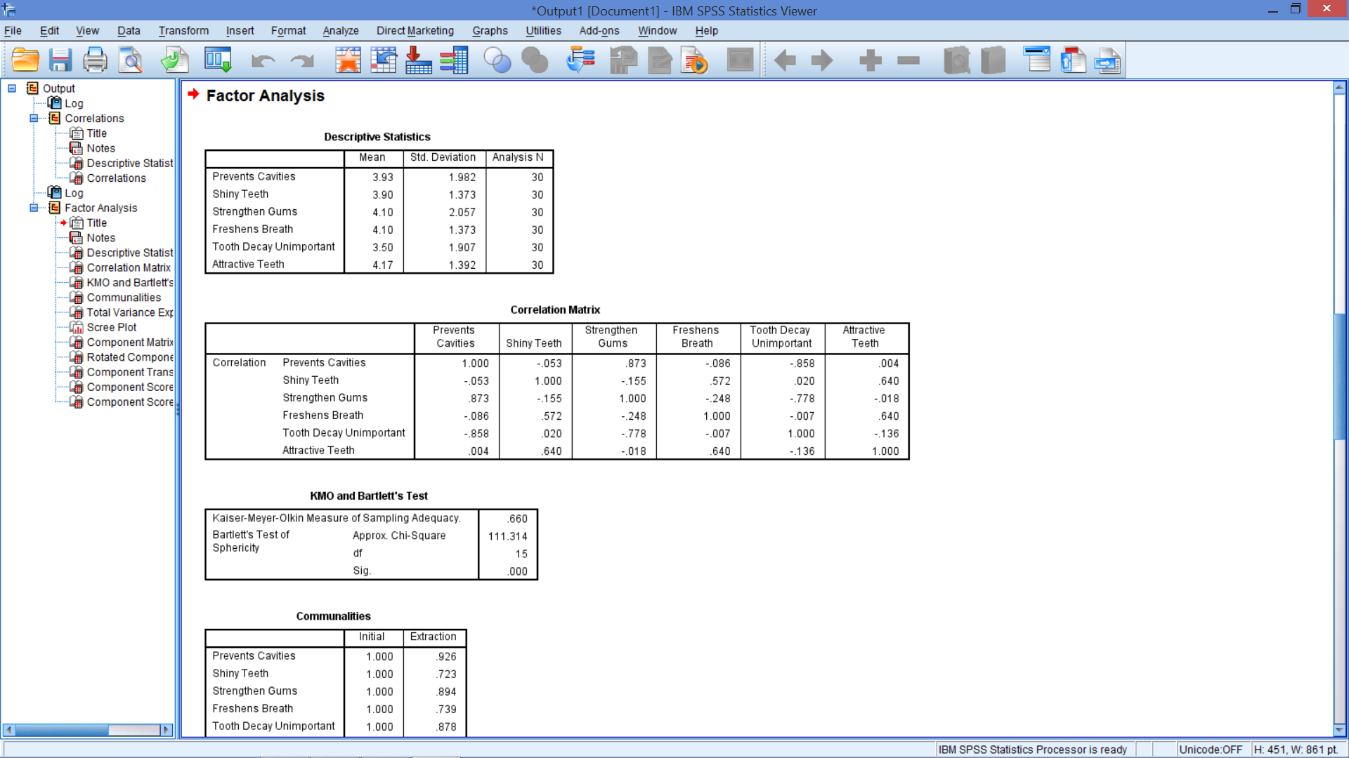
Descriptive Statistics
Notes:
Note that these analyses do not have to be done separately, as we just did.
Should see same patterns in Correlations Matrix.

Slide 28
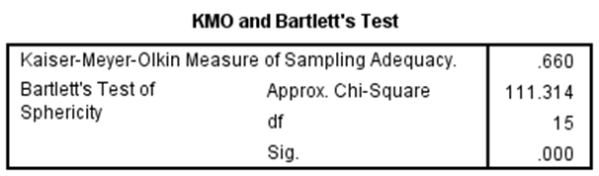
Is Factor Analysis Appropriate?
KMO Measure of Sampling Adequacy
Small values mean variables cannot be explained by other variables
> .50
Bartlett’s Test
H₀: Variables are uncorrelated (No Factor Analysis)
H₁: Variables are correlated
Notes:
The Kaiser-Meyer-Olkin (KMO) measure of sampling adequacy. Small values of the KMO statistic indicate that the correlations between pairs of variables cannot be explained by other variables and that factor analysis may not be appropriate (>0.5).
Another useful statistic is the Bartlett's Test of Sphericity which can be used to test the null hypothesis that the variables are uncorrelated in the population, implying that factor analysis is not appropriate: in other words, the population correlation matrix is an identity matrix.
If this hypothesis cannot be rejected, then the appropriateness of factor analysis should be questioned (Reject H₀).
If this hypothesis can be rejected, then factor analysis can be useful(Reject H0)
Note: Ho Variables ➔ Uncorrelated
H1 Vairiables are correlated.
Since p<0.05 we reject Ho

Slide 29
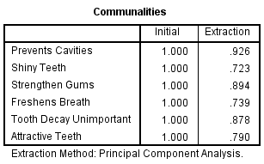

SPSS Output - Communalities
92.6% of variance in the “prevents cavities” variable is explained by the solution
Sum of Extractions = 4.95
Total variance explained
= 4.95/6
= 82.5%
$${\left(x+a\right)}^{n}=\sum_{k=0}^{n}{\left({n \atop k}\right)x^{k}a^{n−k}}$$
Variables are standardized to have variance = 1.
Notes:
Typically use standardized data (the x’s) and standardized component/factor scores (the f’s).
The standardization of each variable is why the Initial Communalities are 1’s for each variable.
“Communalities” - % of variance in each original variable explained by ‘the solution’
Remember our goal is not fto lose too much of the variation in each variable
‘The Solution’ will be explained shortly

Slide 30
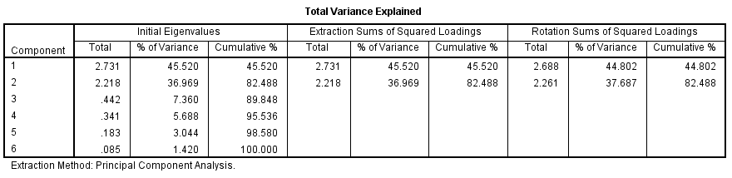
SPSS Output – Variance Explained
2 factors meet latent root criterion (SPSS solution)
Notes:
2.731 / 6 = 45.5%
2.731 + 2.218 = 4.949 (same as previous slide)
4.949 / 6 = 82.5%
2.731 + 2.218 + .442 + .341 + .183 + .085 = 6 (Initial variance)
Good solution captures ≥ 60%
Sum of Initial Eigenvalues
Notes:
Note the first column is labelled component
These are the factors
Labelled component as in Principal component analysis
Since there are 6 variables having 6 components ( or factors) is the trivial solution
Perfect – since cumulative variance explained = 100%
But no dimension reduction
‘’Total variance explained’’ – 82.488% of variance across all original variables explained by the solution– use the eigenvalues to measure.
How many factors to maintain?
Determination Based on Latent Roots (or Eigenvalues). An Eigenvalue represents the amount of variance associated with the factor. In this approach, only factors with latent roots (Eigenvalues) greater than 1.0 are retained. The rationale is that the variation in each variable is 1.0 after the variable has been standardized, and a factor should account for at least that much variation to be considered useful from a data reduction perspective. Essentially, factors with variance less than 1.0 are no better than a single variable. If the number of variables is less than 20, this approach will result in a conservative number of factors.
Determination Based on Percentage of Variance. In this approach the number of factors extracted is determined so that the cumulative percentage of variance extracted by the factors reaches a satisfactory level. It is recommended that the factors extracted should account for at least 60% of the variance.

Slide 31
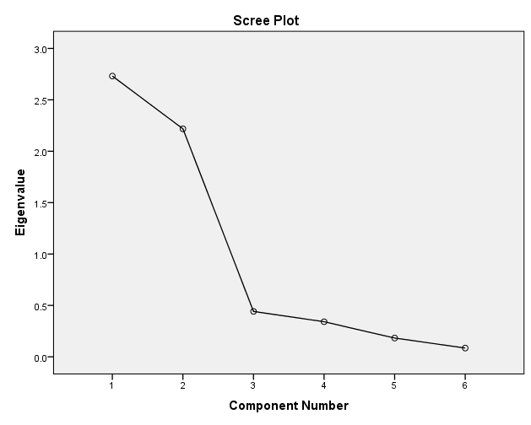
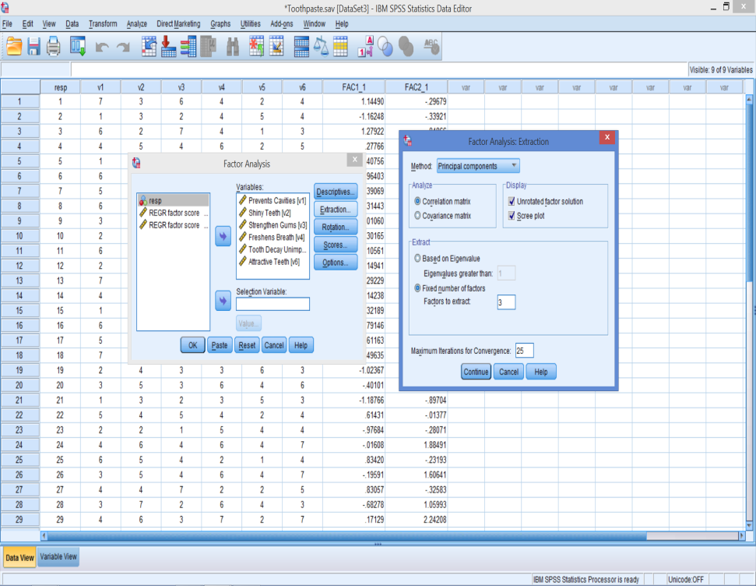
SPSS Output – Scree Plot
Notes:
Determination Based on Scree Plot. A scree test is a plot of the latent roots (Eigenvalues) against the number of factors in order of extraction. Experimental evidence indicates that the point at which the scree (where the “elbow” begins) denotes the true number of factors. Generally, the number of factors determined by a scree plot will be one (or a few) more than that determined by the Eigenvalue criterion.
In this case, the straight line begins at Factor 3, so this may be an option. But, based on the percentage of variance, there is very little gain from 2 to 3 factors.
If you wanted to do this:
In the Extraction box
Uncheck the ‘Based on Eigenvalue’ option
Check the ‘Fixed Number of Factors’
Insert the number of factors in the space provided
In this example, insert 3
Analayse→ Dimension Reduction → Extract

Slide 32
SPSS Output – Variance Explained
Notes:
2.731 / 6 = 45.5%
2.731 + 2.218 = 4.949 (same as previous slide)
4.949 / 6 = 82.5%
2.731 + 2.218 + .442 + .341 + .183 + .085 = 6 (Initial variance)
2 factors meet latent root criterion (SPSS solution)
Good solution captures ≥ 60%
Notes:
“Total variance explained” - % of variance across all original variables explained by the solution – use the eigenvalues to measure.
The main question the analyst must answer is How many factors to maintain?
The eigenvalues solution is 2 factors
The scree plot says- 3 – however based on the percentage of variance gained (7.362%) there is very little to be gained by going from 2 to 3 factors.
For any solution: the ‘cumulative %’ of variance explained should be at least 60%

Slide 33
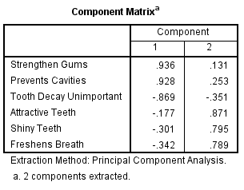
SPSS Output – Factor Loadings
These are the correlations between the original variables and the components (the x’s and the f’s), λ’s

Slide 34
Component Matrix Plot
Notes:
Although the initial or unrotated factor matrix indicates the relationship between the factors and individual variables, it seldom results in factors that can be interpreted, because the factors are correlated with many variables.
This graph is not part of the SPSS output , it was created to illustrate how the variables fall onto the factors before the roatation.

Slide 35
WEEK 6 END of BITE 1
10 minute Break

